Slide 1

IoT-Based Paralysis Patient Health Care Project
Presentation on
Presented by:
Name of student:
Aman Gupta (2020041026)
Akash Singh (2020041022)
Abhishek Singh (2020041009)
Akash Singh (2020041023)
Under Supervision
Dr. G.D. Bharti (Assistant Professor)
Department of Electronics and Communication Engineering,
Madan Mohan Malaviya University of Technology, Gorakhpur (UP) , India

Slide 2
Topics Covered
Introduction
Project Flow
Circuit Diagrams
Hardware Design
Components Used
Innovation of Project
Impact and Feasibility of Product
Challenges and Future Enhancements
Conclusion
References

Slide 3
Introduction
The IoT-based Paralysis Patient Healthcare System represents a pivotal breakthrough in healthcare technology, aimed at empowering individuals suffering from paralysis by enabling seamless communication with medical professionals and caregivers.
Empowering Paralysis Patients: Enables seamless communication with medical professionals and caregivers.
Microcontroller-Based Architecture: Engineered with precision, integrating hand motion recognition, and transmitter-receiver circuits.
Wireless Transmission of Commands: Translates movements into actionable commands transmitted via RF signals.
Nerve Center Receiver System: Processes commands and displays on an intuitive LCD interface.
Remote Accessibility: Vital information accessible online, enabling prompt responses and comprehensive care.

Slide 4
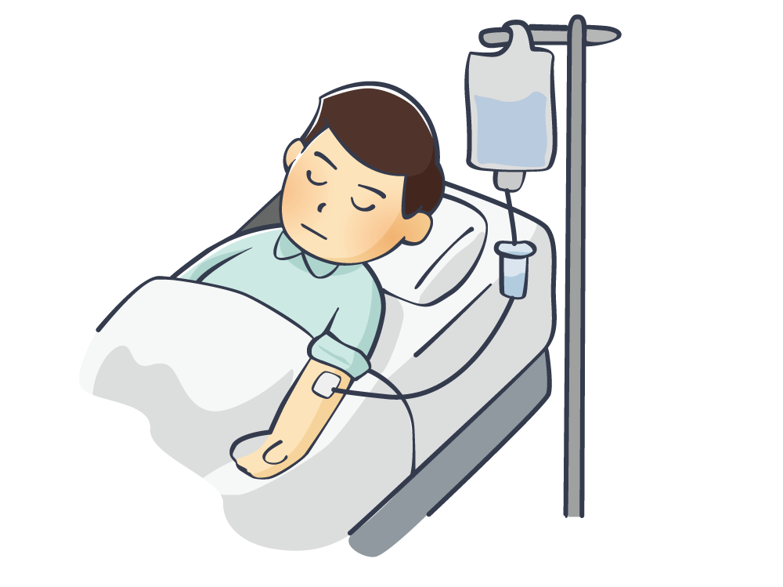
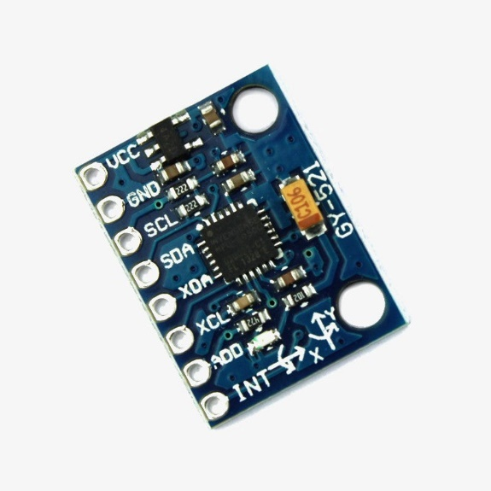
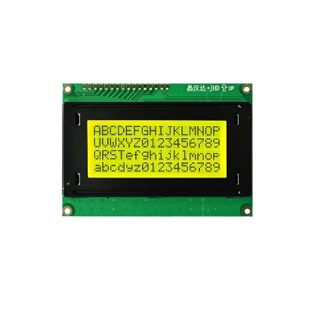

PROJECT FLOW
TRANSMITTER
MPU 6050
ACCELEROMETER
1 KM DISTANCE (Radio Frequency)
PATEINT
RECEIVER
LCD DISPLAY
CARETAKER

Slide 5
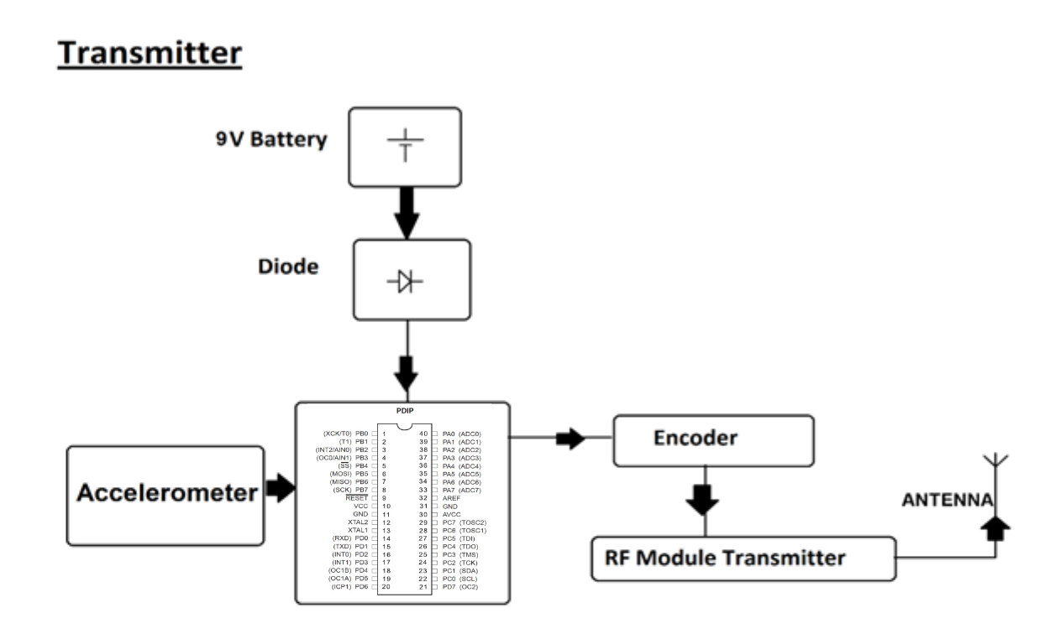
Block Diagram and Circuit Description

Slide 6
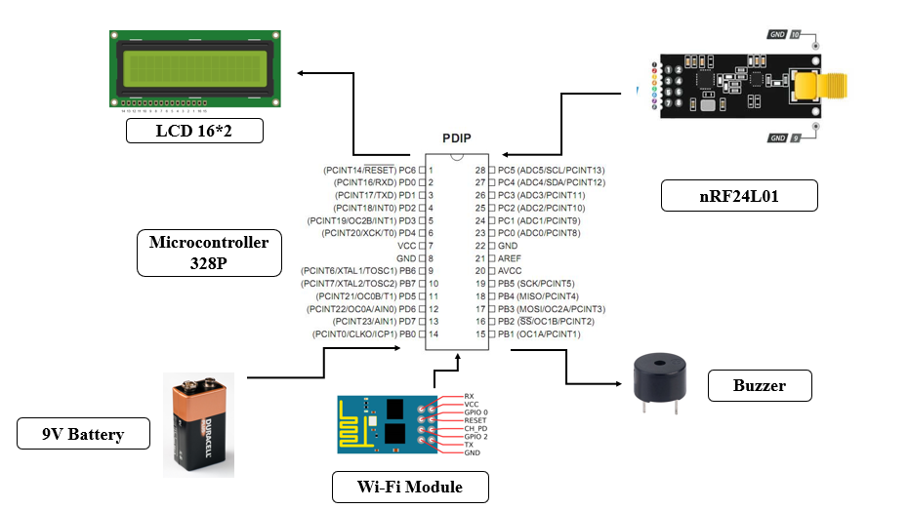
Block Diagram and Circuit Description
Receiver

Slide 7
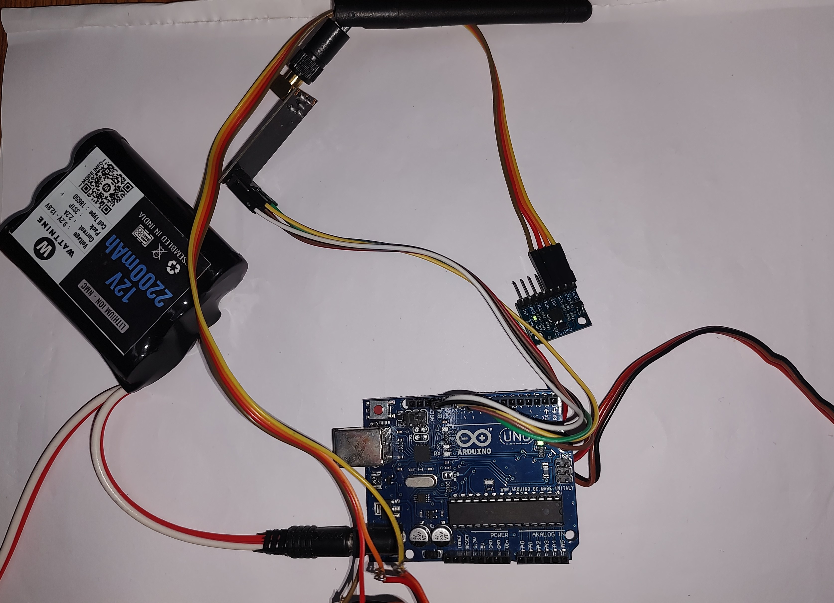
Hardware Design
TRANSMITTER

Slide 8
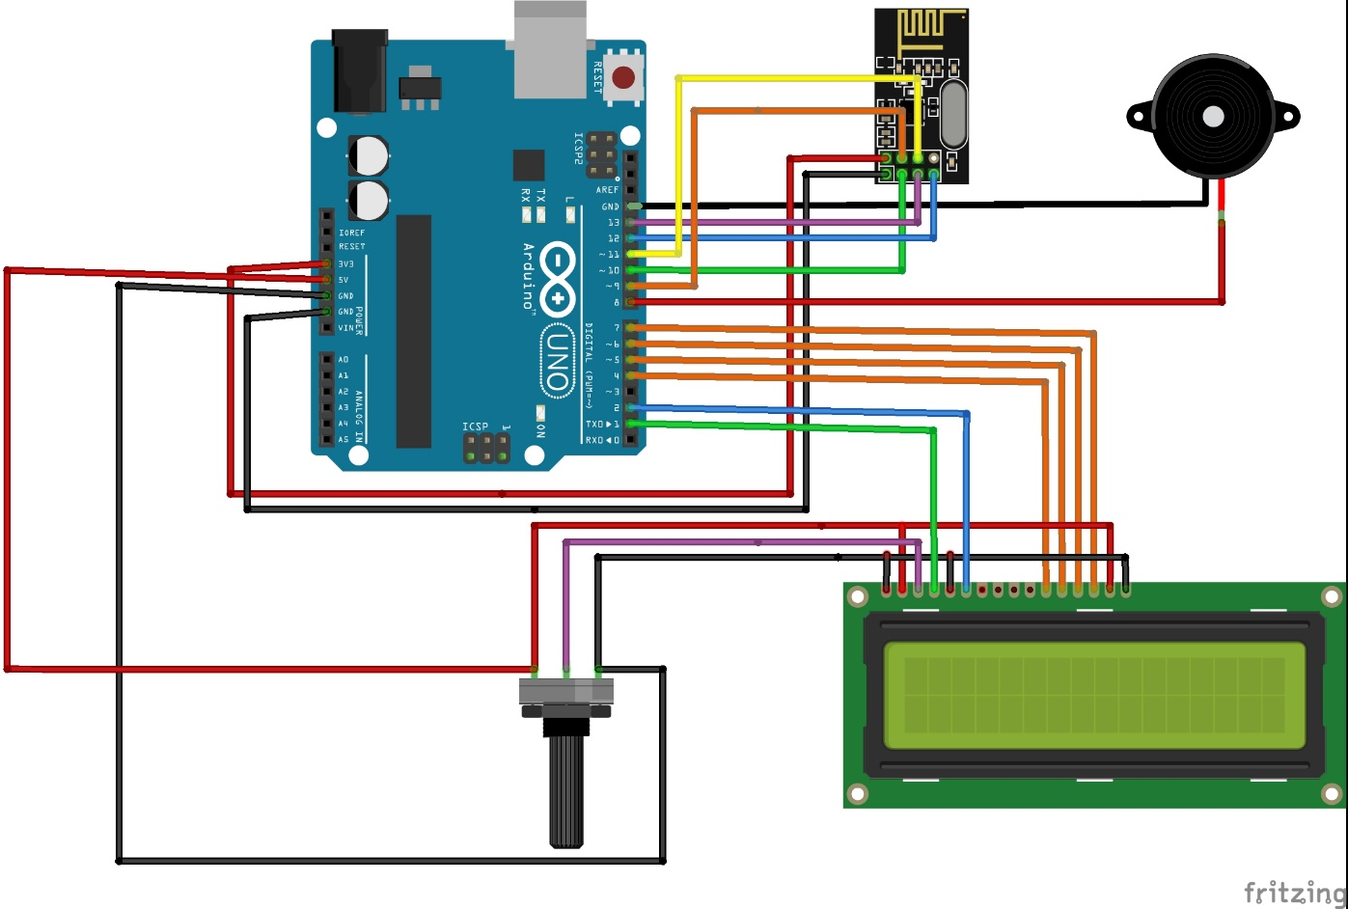
Hardware Design
RECEIVER

Slide 9
Technology and Components Used
Technology used:
Hand Motion Recognition Circuitry:
Incorporates cutting-edge accelerometer and gyroscopic technologies for precise detection and interpretation of hand movements.
Components:
Microcontroller(ATmega328P (Arduino Board R3 UNO))
MPU 6050 Accelerometer
RF Transmitter and Receiver (2.4GHz NRF24L01+PA+LNA SMA Wireless Transceiver Antenna)
Original JHD 16×4 Character LCD Display with Yellow Backlight

Slide 10
Innovation of Project
Holistic Care and Prompt Responses: The system doesn’t just focus on patient-doctor communication but aims for a holistic approach by involving caregivers and family.
Empowerment and Autonomy: By transcending physical limitations and providing a means for patients to express needs, emergencies, or updates, the system significantly empowers patients, granting them a newfound level of autonomy in their care.
Streamlined Healthcare Processes: The system's ability to streamline communication between different stakeholders in healthcare—patients, caregivers, and medical professionals—creates a more connected and responsive ecosystem. This could potentially lead to more efficient and effective healthcare delivery.
Paradigm Shift in Healthcare Technology: The integration of hardware, IoT, and medical care represents a paradigm shift in healthcare technology. It showcases a move towards more integrated, patient-centric, and technologically advanced solutions that transcend traditional boundaries.

Slide 11
Impact and Feasibility of Product
The IoT-based paralysis patient healthcare system not only revolutionizes communication for patients with limited mobility but also significantly impacts the efficiency, quality, and responsiveness of healthcare services, ultimately improving the overall patient experience and well-being.
Enhanced Communication and Autonomy
Efficient Healthcare Communication
Remote Monitoring and Support
Improved Quality of Care
Increased Patient Comfort and Confidence

Slide 12
Challenges and Future Enhancements
Challenges Faced:
Accuracy and Calibration: Ensuring precise calibration of the hand motion recognition system for accurate interpretation of gestures can be challenging.
Wireless Connectivity: Maintaining consistent and reliable wireless connectivity between the transmitter and receiver over longer distances.
Integration Complexity: Managing the integration of various hardware components and ensuring their seamless operation can pose challenges during development.

Slide 13
Challenges and Future Enhancements
Future Enhancements:
Advanced Gesture Recognition: Implementing machine learning or AI algorithms for more advanced gesture recognition, enhancing accuracy and expanding gesture vocabulary.
Wearable Technology: Developing wearable devices or smaller, more portable versions of the system for increased patient convenience and mobility.
Interactivity and Voice Integration: Incorporating voice commands or touchless interfaces for patients with more severe mobility limitations.
Security Measures: Enhancing system security to safeguard patient data and ensure privacy in data transmission over the internet.

Slide 14
Conclusion
The IoT-based Paralysis Patient Healthcare System represents a transformative leap in healthcare technology.
Through meticulous integration of hardware and IoT functionalities, this system enables seamless communication for patients with limited mobility.
By leveraging gesture recognition, wireless transmission, and IoT connectivity, it empowers patients to convey crucial messages to caregivers and healthcare providers. Successful implementation showcases enhanced patient autonomy, streamlined healthcare communication, and the potential for future advancements.
This system stands as a beacon of innovation, bridging gaps in healthcare accessibility and setting the stage for more inclusive, responsive, and patient-centric technological solutions in the future.

Slide 15
References
MACFOS. How to Interface MPU6050 with the Arduino - Robu.in | Indian Online Store | RC Hobby | Robotics. robu.in/mpu6050-with-arduino/.
“Arduino.” Www.electronicwings.com, www.electronicwings.com/arduino. Accessed 25 Dec. 2023.
J. Wang, M. Wang, K. Zheng, and X. Huang, "Model Checking nRF24L01-Based Internet of Things Systems," 2018 9th International Conference on Information Technology in Medicine and Education (ITME), Hangzhou, China, 2018, pp. 867-871, Doi: 10.1109/ITME.2018.00194.
Design and Implementation of Fall Detection System Using MPU6050 Arduino
Inclusive Smart Cities and Digital Health, 2016, Volume 9677
ISBN: 978-3-319-39600-2
Ziad Tarik Al-Dahan, Nasseer K. Bachache, Lina Nasseer Bachache

Slide 16
THANK YOU

